Slide 1
Blogging
A guide to….
under the following license.

Slide 2
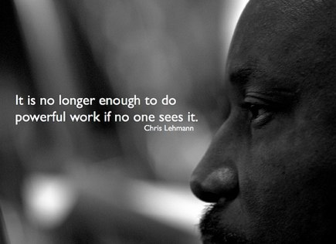
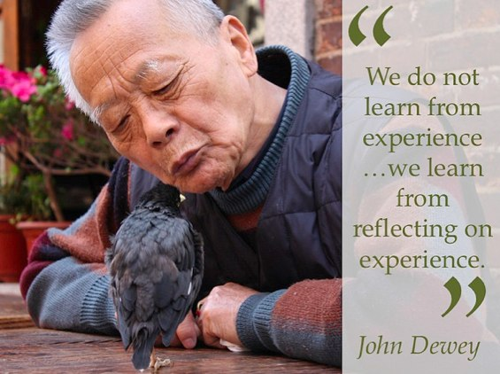
Blogs: Why?
under the following license.
under the following license.

Slide 3
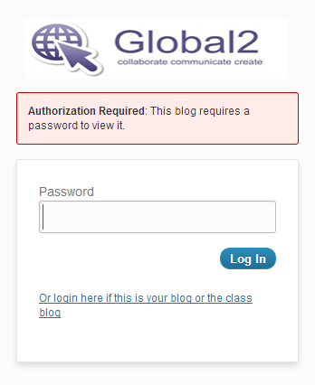
Blog Considerations: Privacy
In consultation with parents, the principal and ICT coordinator, schools must decide:
Will the general public be able to view the blog? (i.e. a potential global audience)
Will the blog be password protected? (i.e. so only people given the password can access the blog)
Can the blog password be given out to family and friends so they can view and subscribe to the blog?

Slide 4
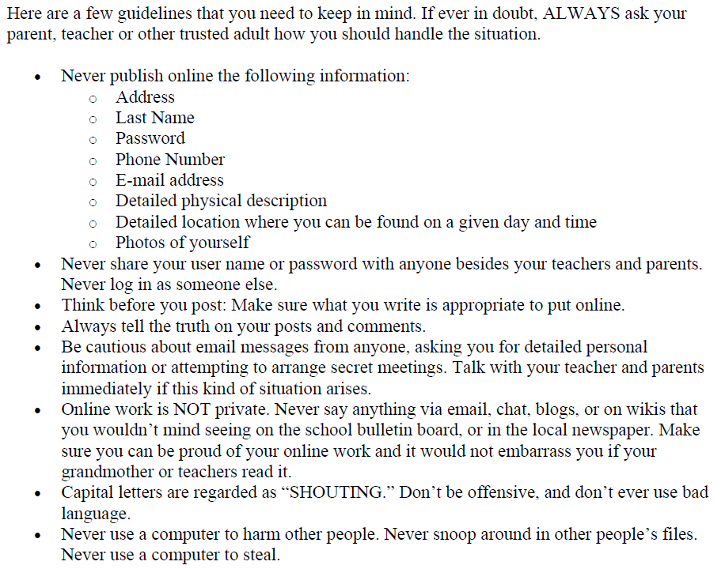
Blog Considerations: Think Before You Post
Watch: http://www.youtube.com/watch?v=rbpKawqA6VQ
under the following license.

Slide 5
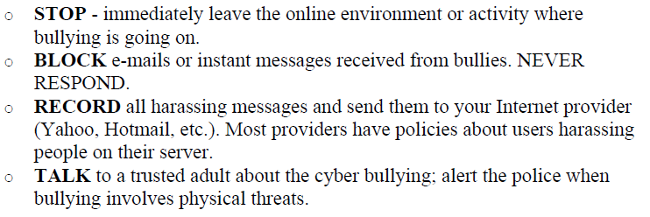
Blog Considerations: Cyber Bullying
For Your Safety…
Your teacher receives notifications of every post.
Watch:
http://www.youtube.com/watch?v=rbpKawqA6VQ
under the following license.

Slide 6
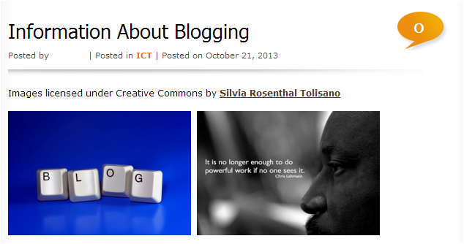
Blog Considerations: Copyright
Watch:
under the following license.
Fair(y) Use (Video)
http://www.youtube.com/watch?v=CJn_jC4FNDo
Creative Commons - Explained (Video)
http://www.youtube.com/watch?v=AeTlXtEOplA
under the following license.
Changes made.

Slide 7
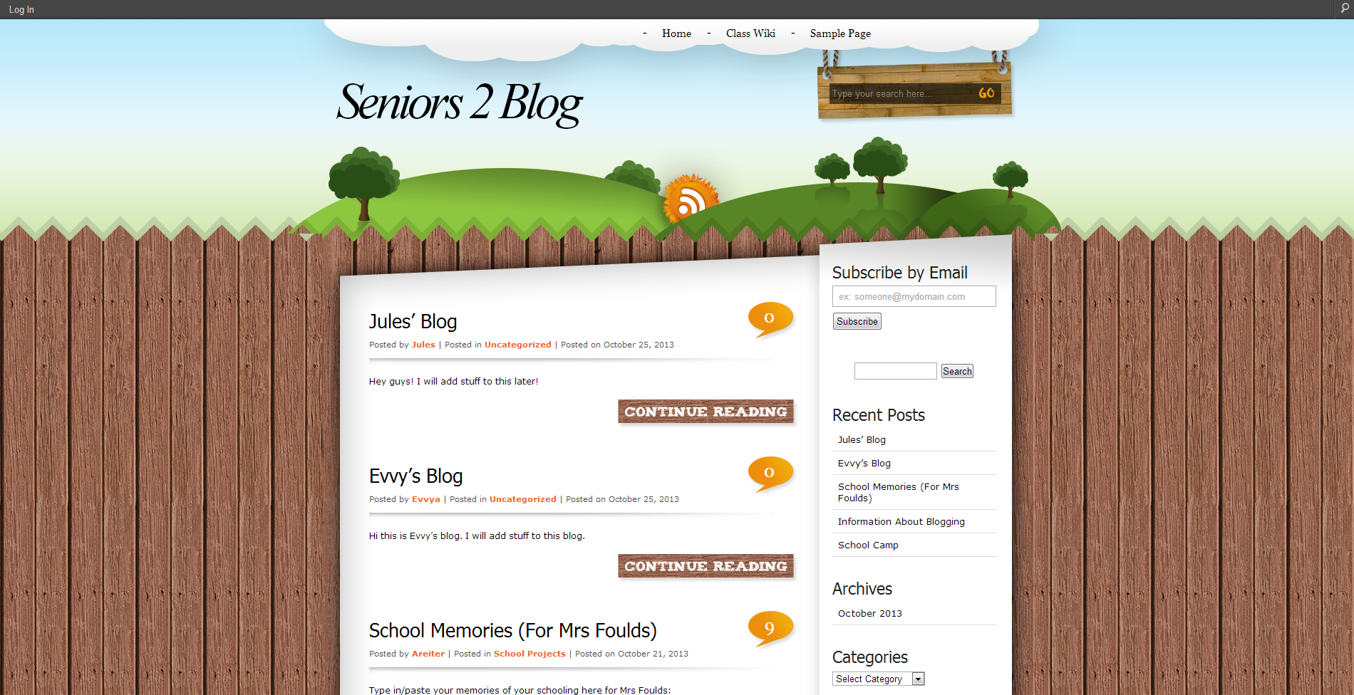
Blogs: Navigating & Vocabulary
under the following license.
Changes made.

Slide 8
Blogs: Posts vs Pages
Pages are listed in the top navigation bar.
They are not listed by date.
Posts are listed in reverse chronological order.
under the following license.
Changes made.

Slide 9
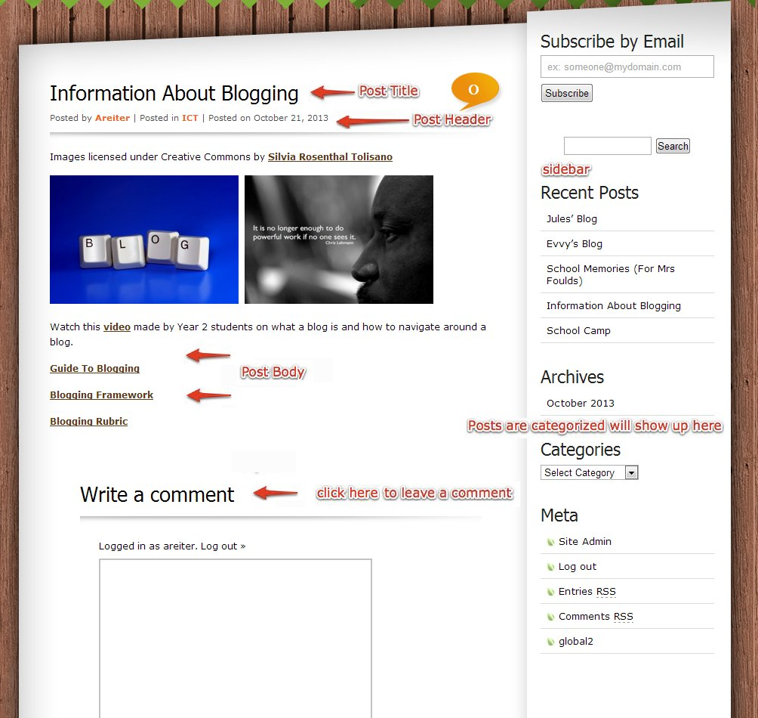
Blogs: Navigating
under the following license.
Changes made.

Slide 10
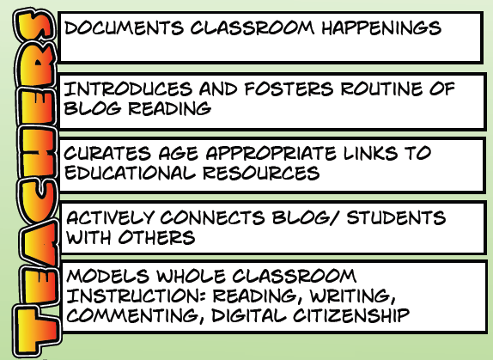
Blogging:
What has your teacher done so far?
under the following license.

Slide 11
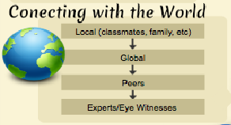
Blogging: Why?
under the following license.

Slide 12
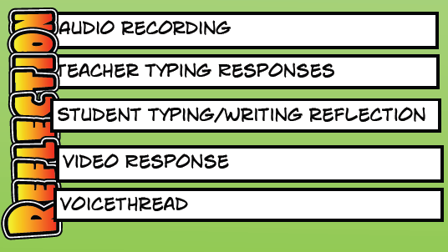
Blogging:
Types of Blogging
under the following license.

Slide 13
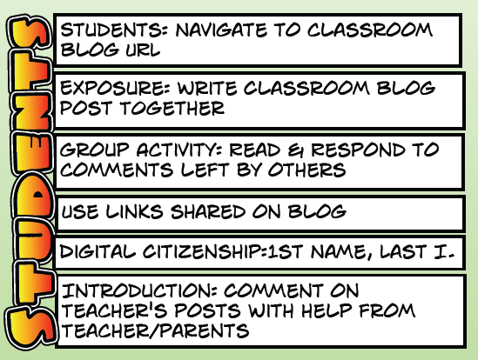
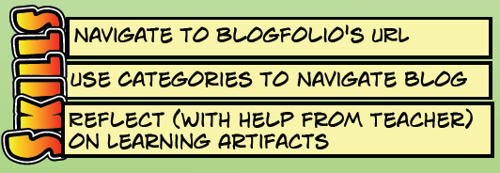
Blogging:
What have you done so far?
under the following license.
Changes made.

Slide 14
Blogging:
What have you done so far?
under the following license.

Slide 15
Blogs: The Dashboard
under the following license.
Changes made.

Slide 16
Blogs: How to Make A Post
under the following license.
Changes made.

Slide 17
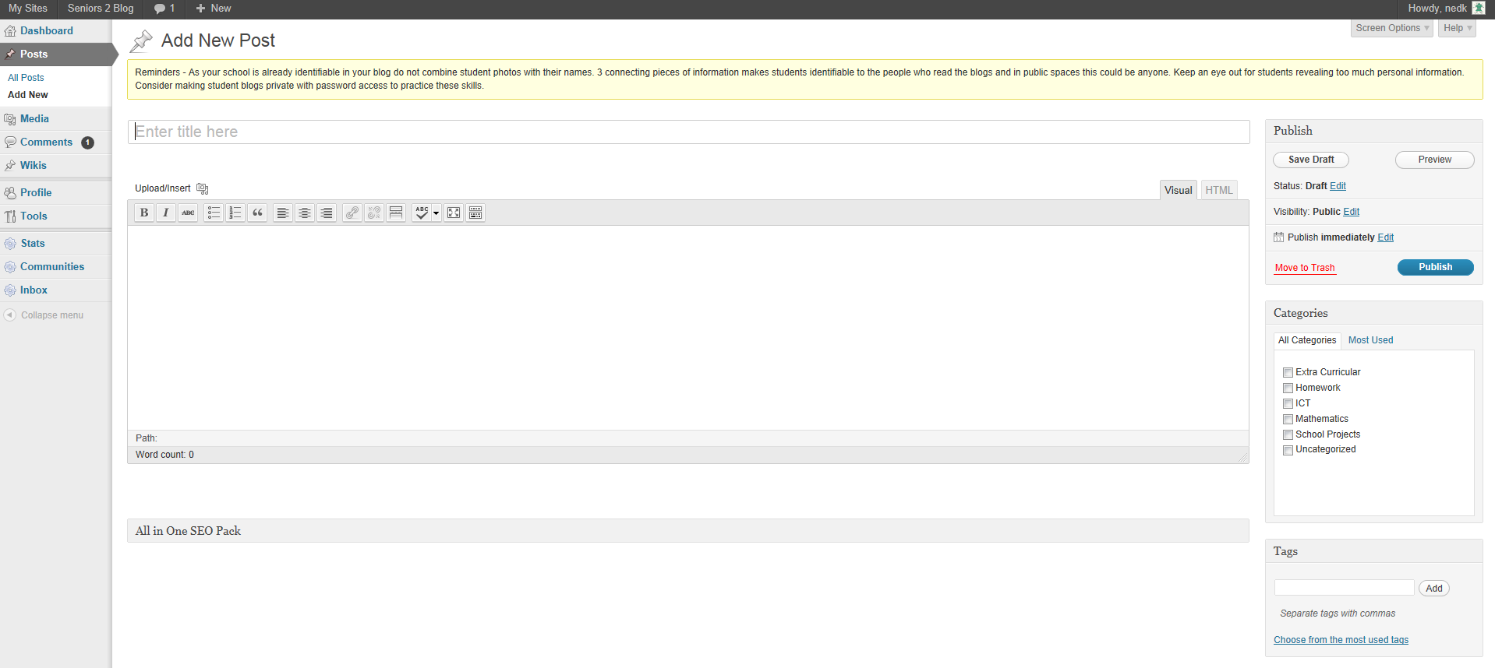
Blogs: How to Make A Post
under the following license.
Changes made.

Slide 18
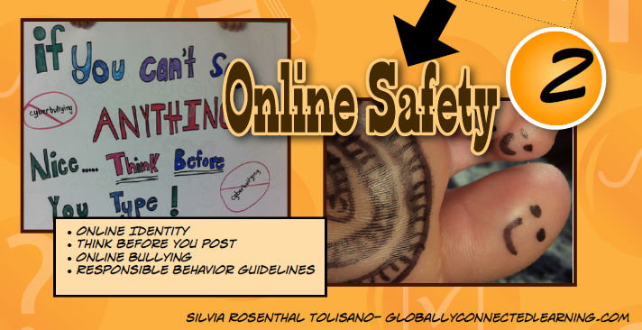
Blogging: Considerations
Online Identity
To ensure for your online safety, only provide one form of identification.
Never reveal your last name (first initial is ok), your school name or use a photo of yourself (use an avatar).
under the following license.

Slide 19
Blogging: Considerations
Online Identity
To ensure for your online safety, only provide one form of identification.
Never reveal your last name (first initial is ok), your school name or use a photo of yourself (use an avatar).

Slide 20
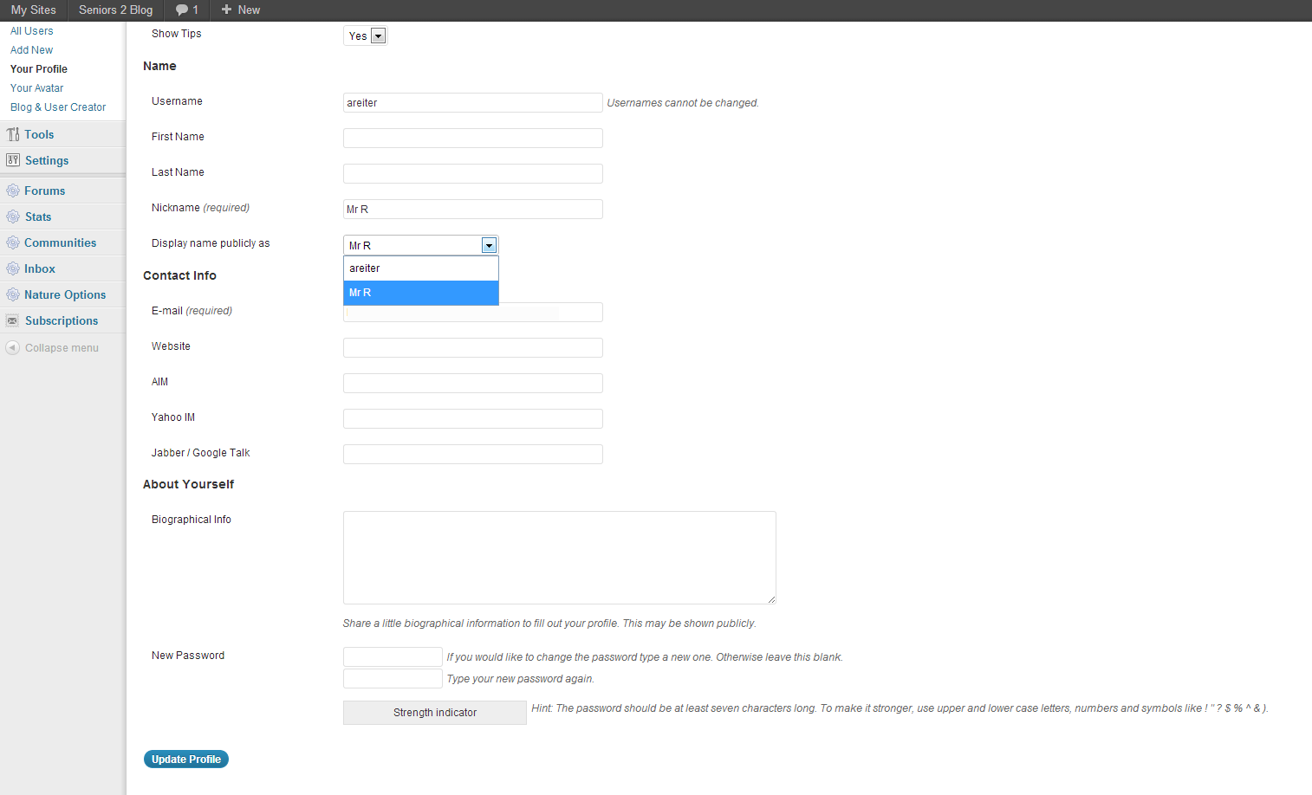
Blogging: Considerations
How To Change Your Nickname
under the following license.
Changes made.

Slide 21
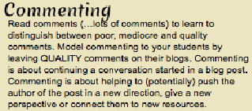
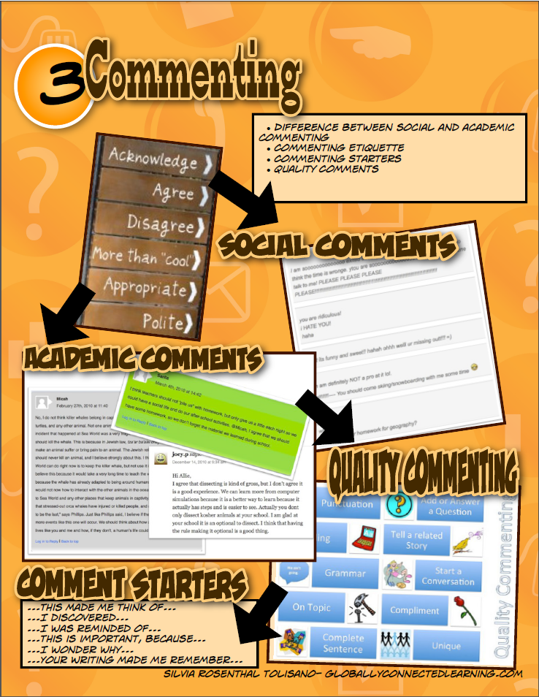
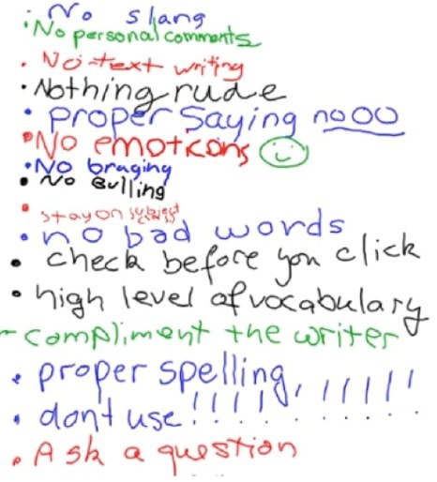
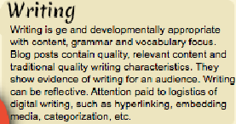
Blogging: Considerations
under the following license.
Changes made.

Slide 22
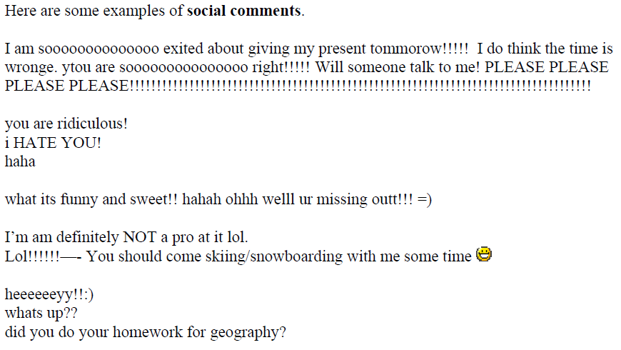
Blogging: Considerations
Social vs Academic Commenting
under the following license.

Slide 23
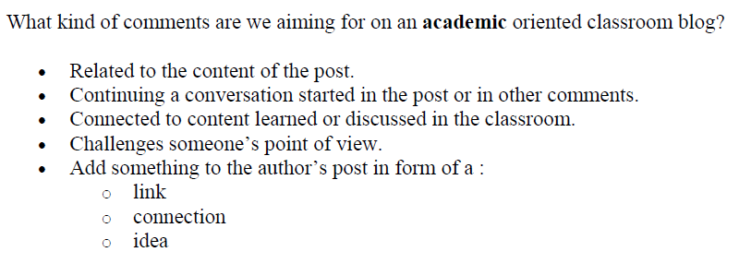
Blogging: Considerations
Social vs Academic Commenting
under the following license.

Slide 24
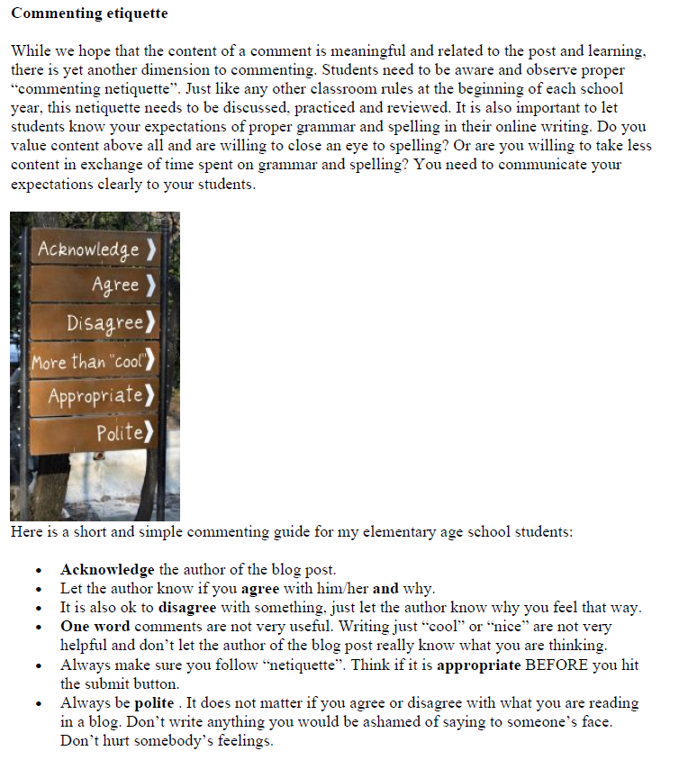
Blogging: Considerations
under the following license.

Slide 25
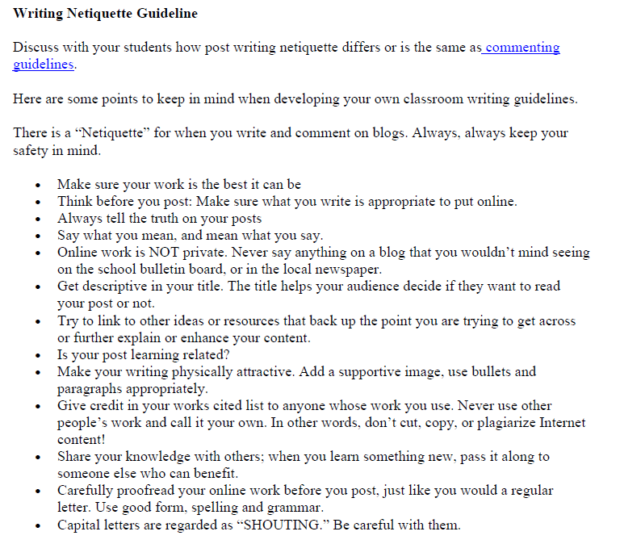
Blogging: Considerations
under the following license.

Slide 26
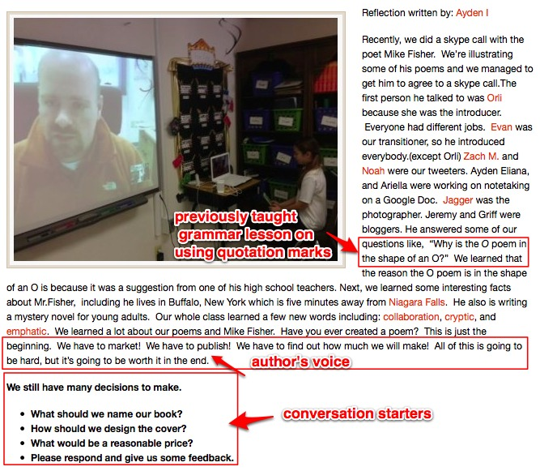
Blogging: Considerations
Hyperlinks to student blogs.
under the following license.

Slide 27
Blogging: Considerations
Let’s visit our blog to monitor the quality of our blogging!

Slide 28
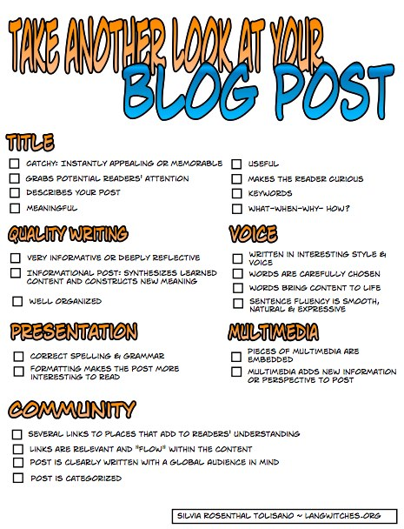
Blogging: Considerations
under the following license.

Slide 29
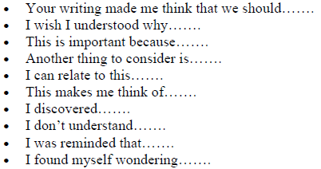
Blogging: Comment Starters
under the following license.

Slide 30
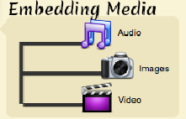
Blogging: Where To Next?
under the following license.
Changes made.

Slide 31
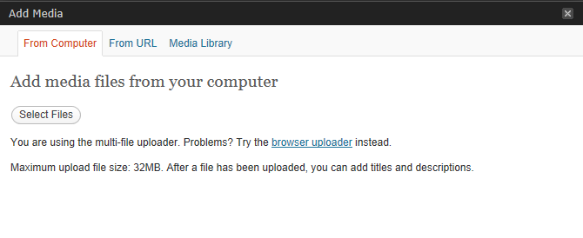
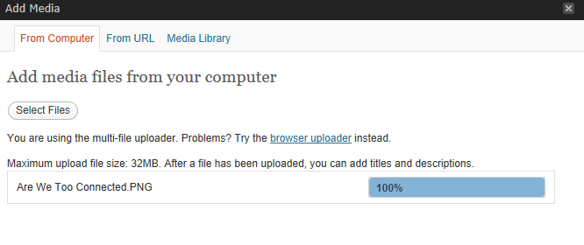
Blogging: Where To Next?
Then wait…
under the following license.
Changes made.

Slide 32
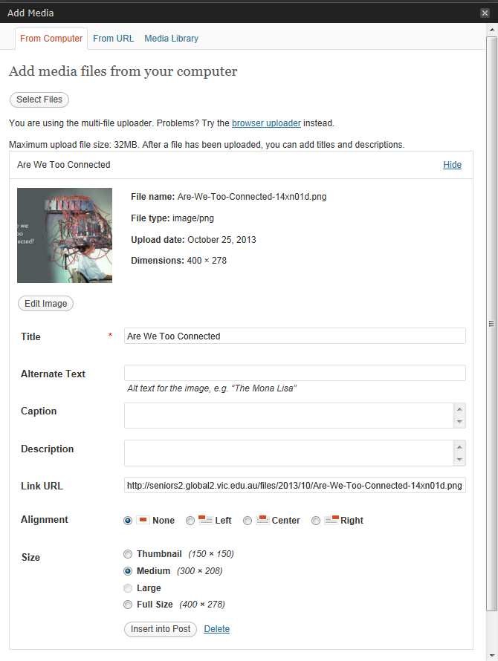
Blogging: Where To Next?
Then wait…
under the following license.
Changes made.

Slide 33
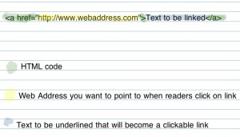
Blogging: Where To Next?
HTML Scripting & Hyperlinking
Adding digital writing conventions (linking)
under the following license.
Changes made.

Slide 34
Blogging: Where To Next?
HTML Scripting & Hyperlinking
under the following license.
Changes made.

Slide 35
Blogging: Where To Next?
HTML Scripting & Embedding Videos
Want to make a video window appear into your blog instead of just a link to a video?
Paste in the following code, replacing “INSERT WEB ADDRESS HERE”, with the link to your video
<iframe width="560" height="315" src=“INSERT WEB ADDRESS HERE" frameborder="0" allowfullscreen></iframe>
* You can change the size of the video window by adjusting the length and width numbers.
* You can add a border around the video by changing frameborder="0" to frameborder=“1"
REMEMBER, IF YOU EMBEDD A VIDEO YOU MUST OBEY COPYRIGHT LAW!
See the next slide for an example.

Slide 36
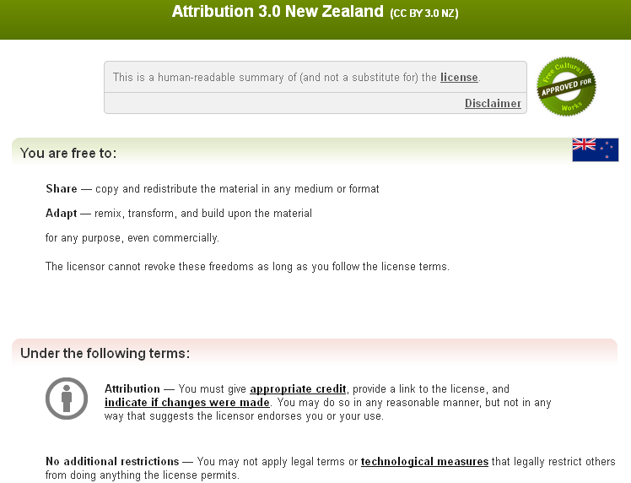
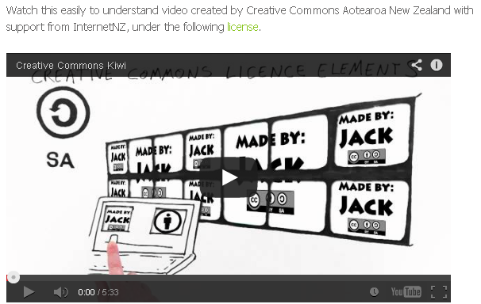
REMEMBER, IF YOU EMBEDD A VIDEO YOU MUST OBEY COPYRIGHT LAW!

Slide 37
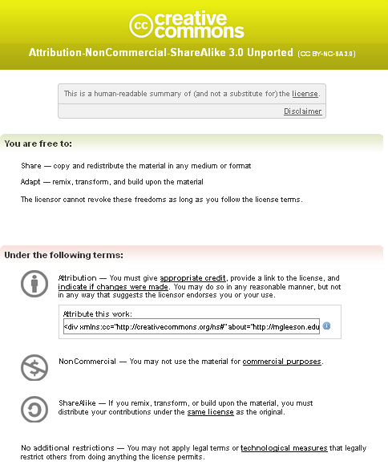
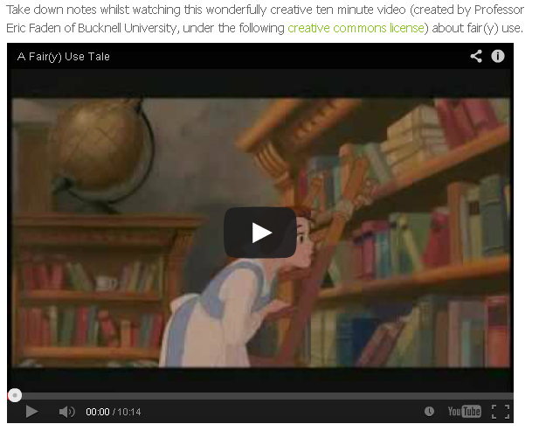
REMEMBER, IF YOU EMBEDD A VIDEO YOU MUST OBEY COPYRIGHT LAW!

Slide 38
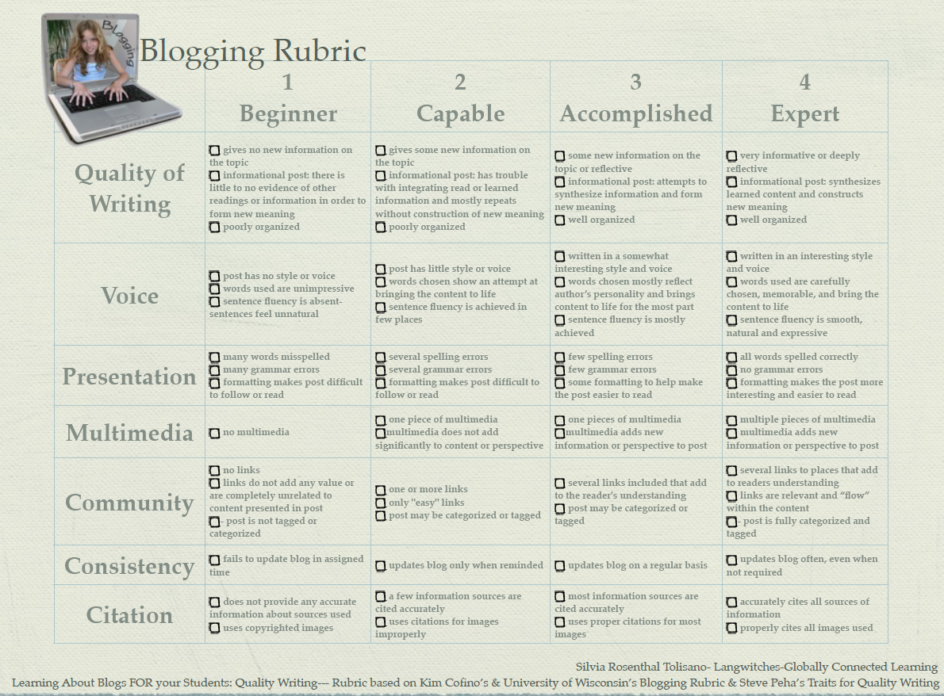
Blogging: Considerations
under the following license.

