Slide 1
ACMSP116 & ACMSP144
List outcomes of chance experiments
involving equally likely outcomes
and represent probabilities of
those outcomes using fractions, decimals and percentages.

Slide 2
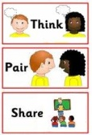
What are some games of chance that you know?

Slide 3
Games of chance include…
Flipping a coin
Rolling a die
Scissors / Paper / Rock
Spinners
Card games (blackjack, poker)
Other:

Slide 4
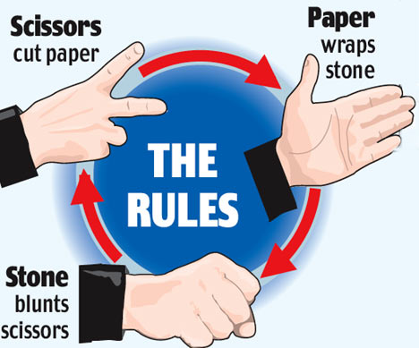
Let’s take a closer look at Scissors, Paper, Rock!

Slide 5
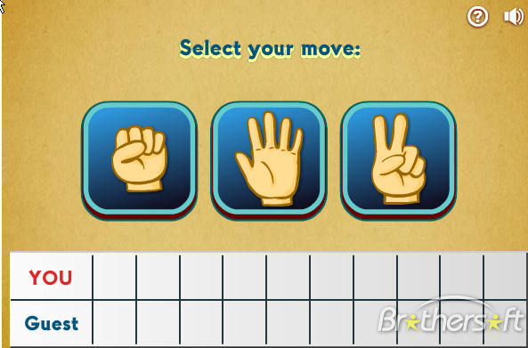
Let’s play
Scissors, Paper, Rock!

Slide 6
Scissors, Paper, Rock!
Play a game against a partner 10 times and record the results copying this table into your books::
My Choice | My Partner’s choice | My Result (Win/Loss)

Slide 7
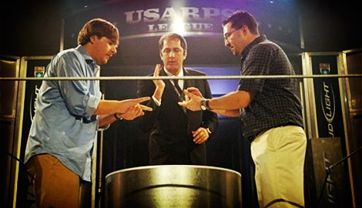
Games of Chance: Scissors, Paper, Rock
Did you know there are national competitions for scissors, paper, rock!

Slide 8
“Equally Likely”
….unless you always choose rock! ☹
You can be beaten by paper, draw with rock or win with scissors!

Slide 9
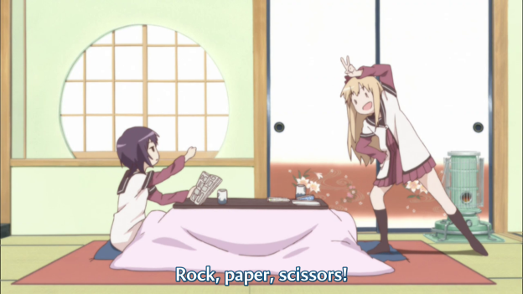
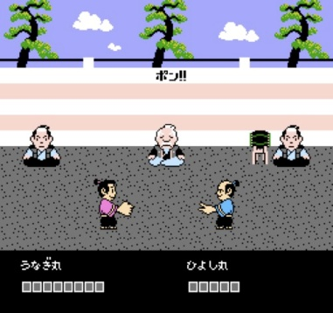
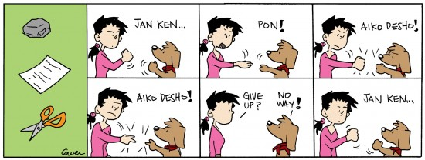
Games of Chance: Jan-Ken-Pon (Rock, Paper, Scisors)
Rock, paper, scissors is thought to have originated from Asia! In Japan, the game is called “jankenpon” or “janken” for short. The game is usually played for the best of three.
In Japan, you say “jan” on the first beat, “ken” on the second beat, and “pon” on the third beat.
If the players both throw the same choice and the round is a tie, they say, “Aikou deshou” (“ai-kou-deshou“). This means “one more time!”

Slide 10
Jan-Ken-Pon
Play a game against a partner 10 times and record the results copying this table into your books::
My Choice | My Partner’s choice | My Result (Win/Loss)

Slide 11
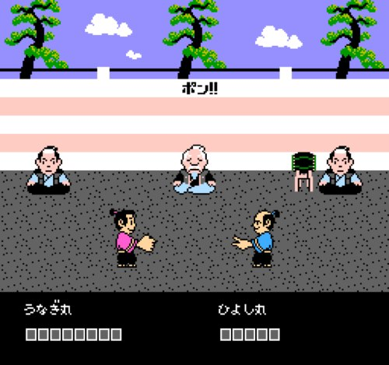
“Hmm…”
If you were playing “Jan-Ken-Pon” what are
the chances of you winning using “Ken”?
(Rock) (Paper ) (Scissors)

Slide 12
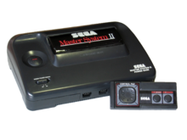
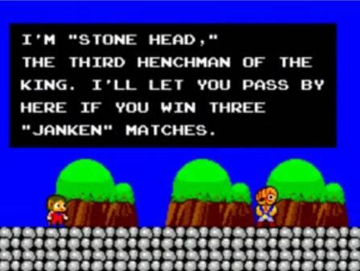
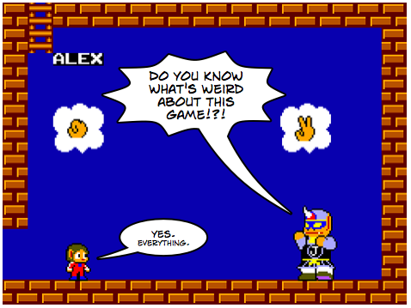
Games of Chance: Jan-Ken-Pon (Rock, Paper, Scisors)
The first game released on the Sega Master System was “Alex The Kidd.” It was the only system released with a free game built into the system’s memory (when you turned it on without a game inserted)!
The bosses for each level were the Janken Brothers who you had to beat playing “Scissors, Paper, Rock!”

Slide 13
There have been many variations of the years…

Slide 14
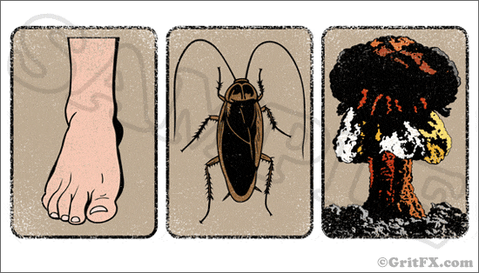
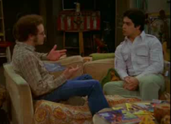
Games of Chance: Foot, Cockroach, Nuclear Bomb!
Foot
Cockroach
Nuclear Bomb
Click picture to play video

Slide 15
Foot, Cockroach, Nuclear Bomb
Play a game against a partner 10 times and record the results copying this table into your books::
My Choice | My Partner’s choice | My Result (Win/Loss)

Slide 16
“Hmm…”
If you were playing “Cockroach, Foot, Nuclear Bomb” what are the chances of you winning using “Cockroach”?

Slide 17
“Equally Likely”
….unless you always choose cockroach! ☹
You can be squashed by foot, draw with cockroach or win by surviving the nuclear bomb!

Slide 18
Games of Chance: Rock, Paper, Scissors, Lizard, Spock!
Click picture to play video

Slide 19
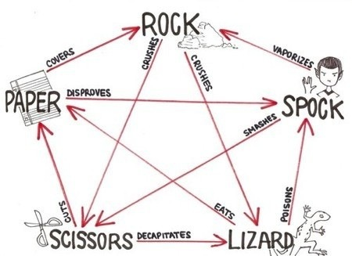
Games of Chance: Rock, Paper, Scissors, Lizard, Spock!
http://www.tumblr.com/tagged/rock-paper-scissor-lizard-spock

Slide 20
Scissors, Paper, Rock, Lizard, Spock
Play a game against a partner 10 times and record the results copying this table into your books::
My Choice | My Partner’s choice | My Result (Win/Loss)

Slide 21
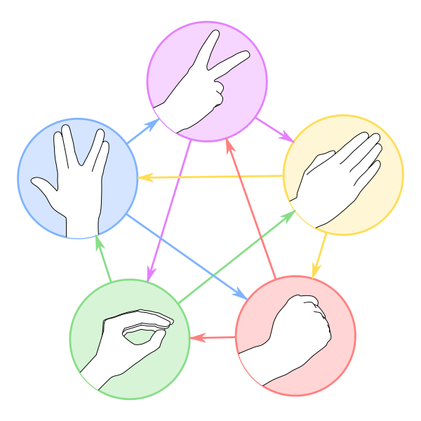
“Hmm…”
If you were playing “Scissors, Paper, Rock, Lizard, Spock” what are the chances of you winning using “Spock”?
Scissors
Spock
Paper
Lizard
Rock

Slide 22
“Equally Likely”

Slide 23
What other mathematical language/numbers can we use to describe the probability of winning a game of “Scissors, Paper, Rock”?

Slide 24
“Equally Likely”
“Equally likely” means…
Has the same chance of happening.
1 in 3
1/3
33.334%
Your can either use
Scissors,
Paper, or
Rock
And (i) win, (ii) lose or (iii) draw!

Slide 25
Hmm..
How did the odds change when you moved from playing the 3 outcome games to the 5 outcome game (Paper, Scissors, Rock, Lizard, Spock) ?

Slide 26
Describing Mathematical Probability...
using fractions
Q4: Use a fraction to describe the mathematical probabilities for playing “Scissor, paper, rock”:
(a) pr(scissor)= (b) pr(paper)= (c) pr(rock)=
Q5: Use a fraction to describe the mathematical probabilities for playing “Jan-Ken-Pon”:
(a) (b) (c)
Q6: Use a fraction to describe the mathematical probabilities for playing “Cockroach, Foot, Nuclear Bomb”:
(a) pr(Cockroach)= (b) pr(Foot)= (c) pr(Nuclear Bomb)=

Slide 27
Describing Mathematical Probability...
using percentages
Q4: Use a percentage to describe the mathematical probabilities for playing “Scissor, paper, rock”:
(a) pr(scissor)= (b) pr(paper)= (c) pr(rock)=
Q5: Use a percentage to describe the mathematical probabilities for playing “Jan-Ken-Pon”:
(a) (b) (c)
Q6: Use a percentage to describe the mathematical probabilities for playing “Cockroach, Foot, Nuclear Bomb”:
(a) pr(Cockroach)= (b) pr(Foot)= (c) pr(Nuclear Bomb)=

Slide 28
Describing Mathematical Probability...
using decimals
Q4: Use a decimal to describe the mathematical probabilities for playing “Scissor, paper, rock”:
(a) pr(scissor)= (b) pr(paper)= (c) pr(rock)=
Q5: Use a decimal to describe the mathematical probabilities for playing “Jan-Ken-Pon”:
(a) (b) (c)
Q6: Use a decimal to describe the mathematical probabilities for playing “Cockroach, Foot, Nuclear Bomb”:
(a) pr(Cockroach)= (b) pr(Foot)= (c) pr(Nuclear Bomb)=

Slide 29
“Hmm…”
What are some other events in life that are “equally likely”?

Slide 30
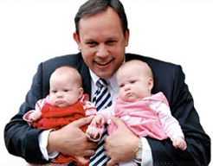
“Hmm…”
If you mum has had three baby girls and is pregnant, what are the chances it will be another girl?

Slide 31
“Equally Likely”
Your mum can either have a boy or a girl! Statistically speaking, the chances are still the same even if she has had three girls before..even ask the doctor!

Slide 32
“Equally Likely”
What other mathematical language/numbers can we use to describe the probability of a mum having a boy or girl?

Slide 33
“Equally Likely”
means…
Has the same chance of happening.
1 in 2
1
2
50 / 50 (50% / 50%)

Slide 34
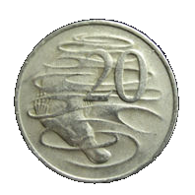
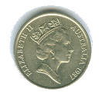
“Hmm…”
If you had flipped a coin and 5 times in a row it came up heads, what are the chances the next time you flip it will be heads?

Slide 35
“Equally Likely”
“Equally likely” means…
Has the same chance of happening.
1 in 2
50 / 50 (50% / 50%)
A coin has 2 sides. Heads & tails! Statistically speaking, the chances must be 50/50
(unless you’ve got a dodgy coin!)

Slide 36
“Equally Likely”
What other mathematical language/numbers can we use to describe the probability of a flipping a coin?

Slide 37
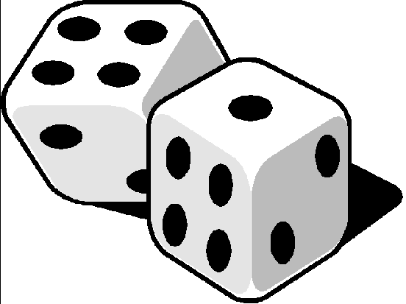
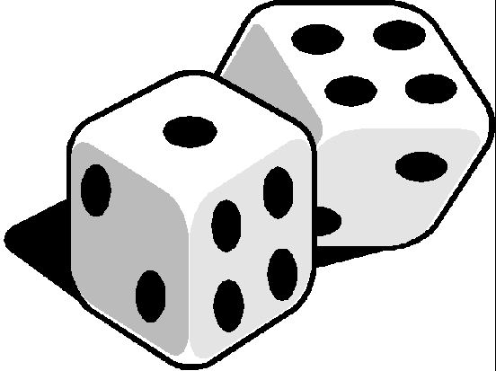
“Hmm…”
If you were rolling a die and you had rolled 6 two times in a row, what are the chances that you will roll six again?

Slide 38
“Equally Likely”
Your can either roll a 1, 2, 3, 4, 5, 6.

Slide 39
“Equally Likely”
What other mathematical language/numbers can we use to describe the probability of what could happen when you roll a die?

Slide 40
“Equally Likely”
“Equally likely” means…
Has the same chance of happening.
1 in 6
1/6
16.6666666666666666667%
Your can either roll a 1, 2, 3, 4, 5, 6. Statistically speaking, the chances must be 1 in 6
(unless you’ve got dodgy dice)!

Slide 41
Who though you had a 50/50 chance of rolling a six?
Whoops!
Why is using the term “50/50” wrong when describing the probability outcomes of rolling a die?

Slide 42
Your can either roll a 1, 2, 3, 4, 5, 6. Statistically speaking, the chances must be 1 in 6
(unless you’ve got dodgy dice)!
1 in 6
1/6
16.6666666666666666667% ← Not 50%

Slide 43
Describing Mathematical Probability...
using decimals
Q1: Use a decimal to describe the mathematical probability for flipping a..
(a) head: pr(head) =
(b) tail: pr(tail) =
Q2: Use a decimal to describe the mathematical probability for a mum having a boy or a girl..
(a) pr(boy) =
(b) pr(girl) =
Q3: Use a decimal to describe the mathematical probability for rolling a..
(a) 1: pr(1) = (b) 2: pr(2) = (c) 3: pr(3) =
(d) 4: pr(4) = (e) 5: pr(5) = (f) 6: pr(6) =

Slide 44
Hmm..
What are the consequences if we get an 8 sided die and roll that?

