Slide 1
Types of Numbers
There are many different ways that we can categorise/label/group numbers.
What are some of the ways you that that we can categorise numbers?

Slide 2
Types of Numbers
There are many different ways that we can categorise/label/name numbers.
odd
even
whole number
decimal
fraction
square
triangular
prime
composite
Fibonacci
Some of these numbers have special properties and these properties can be used to solve problems (which you will discover later).

Slide 3
Some of these numbers have special properties and these properties can be used to solve problems.
What makes an number “even”?

Slide 4
Some of these numbers have special properties and these properties can be used to solve problems.
What makes an number “even”?
A number is even if…..
you can divide it by 2 without resulting in a remainder, fraction or decimal.

Slide 5
Some of these numbers have special properties and these properties can be used to solve problems.
What makes an number “odd”?

Slide 6
Some of these numbers have special properties and these properties can be used to solve problems.
What makes an number “odd”?
A number is odd if…..
you can divide it by 2 and it results in a remainder, fraction or decimal.

Slide 7
Some of these numbers have special properties and these properties can be used to solve problems.
How can knowing about “even” or “odd” numbers help us in real life situations?
Knowing house layouts (odd numbered houses on one side of the street, even on the opposite side).
FOR CHECKING OUR CALCULATIONS!!
WT?

Slide 8
Did you know?
If you double an odd number the answer is always an even number.
Double 1 = 2
Double 7 = 14
Why?
By A. Gore

Slide 9
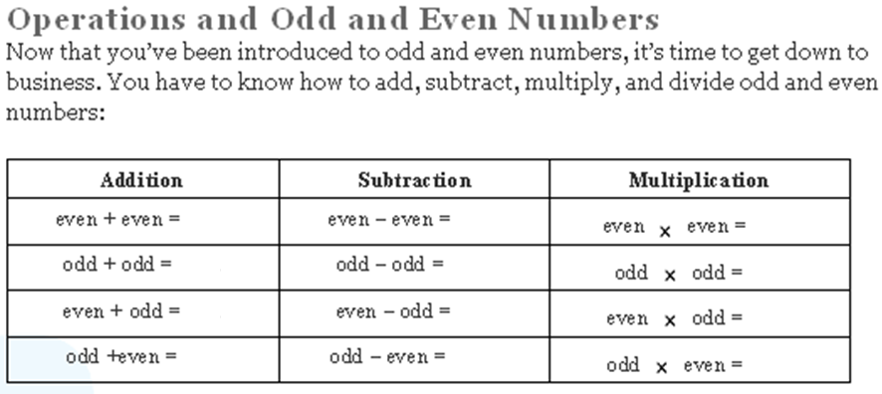
Copy this table into your book.
Using sub-headings, create 5 examples in your book for each box scenario to find the answer.
Then put your answers into the table in your book.

Slide 10
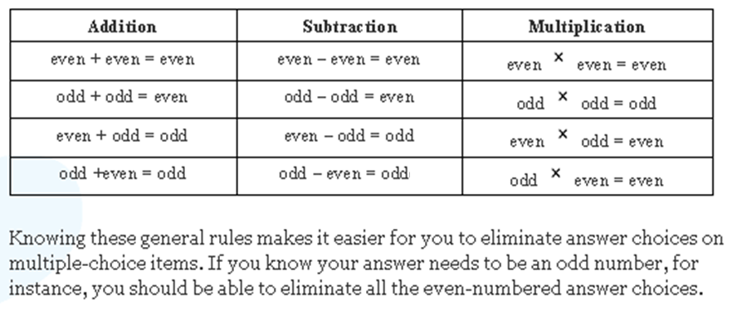
Answers

Slide 11
Operations on Odd & Even Numbers
3 odd numbers
What happens when you..
add three odd numbers?
subtract three odd numbers?
multiply three odd numbers?
divide three odd numbers?
3 even numbers
What happens when you..
add three even numbers?
subtract three even numbers?
multiply three even numbers?
divide three even numbers?

Slide 13
Types of Numbers
What type of numbers do you see?

Slide 14
Types of Numbers: Square Numbers
Square Numbers!
Why do you think these are called square numbers?

Slide 15
Types of Numbers: Square Numbers
2x2=4
3x3=9
4x4=16
5x5=25
6x6=36
1x1 = 1
Because the multiplication of an integer (number) by itself forms a square shape or array!
1x1 = 1
2x2=4
3x3=9
4x4=16
5x5=25
6x6=36

Slide 16
Types of Numbers: Square Numbers
2x2=4
3x3=9
4x4=16
5x5=25
6x6=36
1
Have you ever heard of the term “squared” or seen this:
2
4

Slide 17
Types of Numbers: Square Numbers
2x2=4
3x3=9
4x4=16
5x5=25
6x6=36
1
The term “squared” or this (to the power of 2):
2
4
means a number multiplied by itself:
E.g. 1x1, 2x2, 7x7, 9x9

Slide 18
Types of Numbers: Square Numbers
1
4
9
16
25
36
Square Numbers!
1, 4, 9, 16, 25, 36, …., …., ….
Heading: Square Numbers
Draw this pattern in your book and copy the counting pattern.
Show the for each picture.
3. Continue the pattern to find out what the next 5 numbers are in this pattern.
2
4 = 4x4 = 16

Slide 19
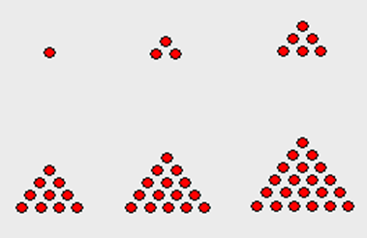
Types of Numbers
What type of numbers do you see?

Slide 20
Types of Numbers: Triangular Numbers
Triangular Numbers!

Slide 21
Types of Numbers: Triangular Numbers
Does anyone know why they are called triangular numbers?

Slide 22
Types of Numbers: Triangular Numbers
Because the multiplication of an integer (number) by itself forms an equilateral triangular or array!

Slide 23
Types of Numbers: Triangular Numbers
1
3
6
10
15
21
Triangular Numbers!
1, 3, 6, 10, 15, 21, …., …..
Heading: Triangular Numbers
1. Draw this pattern in your book and copy the counting pattern.
2. Continue the pattern to find out what the next 5 numbers in this triangular number pattern are.

Slide 24
Types of Numbers: Triangular Numbers
Triangular Numbers:
1, 3, 6, 10, 15, 21, …., …..
Heading: Triangular Number Rule
Could you figure out what the rule is if you were asked to find the next 10 numbers but you had to do it without drawing or counting on in your head? Good luck!

Slide 25
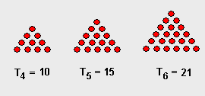
Types of Numbers: Triangular Numbers
Triangular Numbers:
1, 3, 6, 10, 15, 21, …., …..
Triangular Number Rule

Slide 26
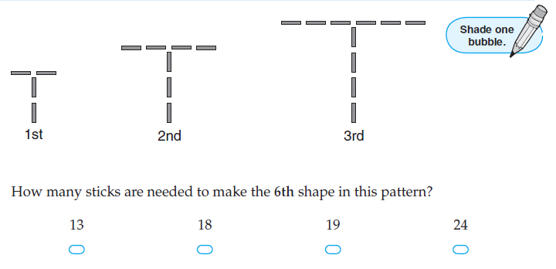
Extension:

Slide 27
Extension:

Slide 28
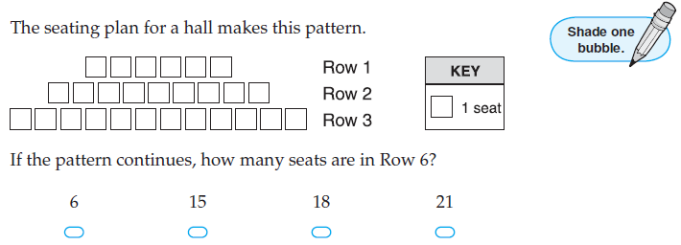
Extension:

Slide 29
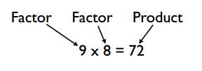
Before we look at the next types of numbers it’s important to remind or teach you the following mathematical vocabulary!
Can you give us an example of 2 factors and their product?

Slide 30
Heading: Factors and Products
Create at least ten multiplication equations using the following table:
Factor 1 (Multiplier 1) | Factor 2 (Multiplier 2) | Product (Answer)
2 | 3 | 6

Slide 31
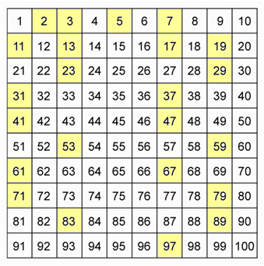
Types of Numbers
What type of numbers do you see?

Slide 32
Types of Numbers: Prime Numbers
Prime Numbers!

Slide 33
Types of Numbers: Prime Numbers
Have you ever heard of the term “prime” numbers?

Slide 34
Types of Numbers: Prime Numbers
Prime numbers are numbers that can only be
divided by
1, or
themselves
to equal a whole number.
Go through an example here:
WT?

Slide 35
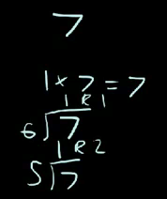
Types of Numbers: Prime Numbers
Prime numbers are numbers that can only be
divided by
1, or
themselves
to equal a whole number.
That’s easy!
So 7 can only be divided by 7 or 1 to get a whole number!
That means 7 is a prime number!

Slide 36
Types of Numbers: Prime Numbers
ALSO KNOWN AS:
A prime number is a number that only has two factors: 1 and the number
(i.e. 53: can only be made of 1x53)
Go through an example here:
WT?

Slide 37
Types of Numbers: Prime Numbers
ALSO KNOWN AS:
A prime number is a number that only has two factors: 1 and the number
(i.e. 53: can only be made of 1x53)
That’s easy!
So 7 can only be made using two factors: 7 and 1 (7x1).
That’s why we can call it a prime number!

Slide 38
Types of Numbers: Prime Numbers
Prime numbers are numbers that can only be
divided by
1, or
themselves
to equal a whole number.
2 / 2 = 1
2 / 1 = 2
These numbers can only every be divided by 1 or themselves to get a whole number!
3 / 3 = 1
3 / 1 = 3
59 / 59 = 1
59 / 1 = 59

Slide 39
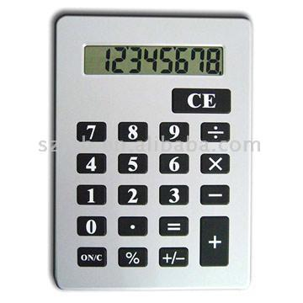
Types of Numbers: Prime Numbers
Let’s test that out!
Choose any number form here (i.e. 47).
On your calculator try:
47 /46 =
47/ 45 =
47/ 44 =
Keep on trying until you get a whole number!

Slide 40
Types of Numbers: Prime Numbers
Prime Numbers
Is there be a quicker way?

Slide 41
Types of Numbers: Prime Numbers
Prime Numbers
Yes!!
Try to draw any of these prime numbers in an array.

Slide 42
Types of Numbers: Prime Numbers
Prime Numbers
What’s an array?

Slide 43
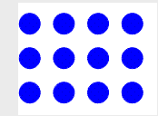
Types of Numbers: Prime Numbers
Prime Numbers
&
Arrays
Remember doing these in grade 2? (They are called arrays!)
6 x 2
Or
2 x 6
12 / 2 = 6
or
12 / 6 = 2
4 x 3
Or
3 x 4
12 / 4 = 3
or
12 / 3 = 4

Slide 44
Types of Numbers: Prime Numbers
Prime Numbers
&
Arrays
Try to make an array for any of these prime numbers!
Good luck!

Slide 45
Types of Numbers: Prime Numbers
Prime Numbers
Is there be a quicker way than drawing?

Slide 46
Types of Numbers: Prime Numbers
Prime Numbers
Yes!!
Check out the awesome way on the following slides….

Slide 47
Take out the number 1 because it is a special number.
Types of Numbers: Prime Numbers
1 | 2 | 3 | 4 | 5 | 6 | 7 | 8 | 9 | 10
11 | 12 | 13 | 14 | 15 | 16 | 17 | 18 | 19 | 20
21 | 22 | 23 | 24 | 25 | 26 | 27 | 28 | 29 | 30
31 | 32 | 33 | 34 | 35 | 36 | 37 | 38 | 39 | 40
41 | 42 | 43 | 44 | 45 | 46 | 47 | 48 | 49 | 50
51 | 52 | 53 | 54 | 55 | 56 | 57 | 58 | 59 | 60
61 | 62 | 63 | 64 | 65 | 66 | 67 | 68 | 69 | 70
71 | 72 | 73 | 74 | 75 | 76 | 77 | 78 | 79 | 80
81 | 82 | 83 | 84 | 85 | 86 | 87 | 88 | 89 | 90
91 | 92 | 93 | 94 | 95 | 96 | 97 | 98 | 99 | 100

Slide 48
Take out numbers that have a composite factor of 2
Types of Numbers: Prime Numbers
 | 2 | 3 | 4 | 5 | 6 | 7 | 8 | 9 | 10
11 | 12 | 13 | 14 | 15 | 16 | 17 | 18 | 19 | 20
21 | 22 | 23 | 24 | 25 | 26 | 27 | 28 | 29 | 30
31 | 32 | 33 | 34 | 35 | 36 | 37 | 38 | 39 | 40
41 | 42 | 43 | 44 | 45 | 46 | 47 | 48 | 49 | 50
51 | 52 | 53 | 54 | 55 | 56 | 57 | 58 | 59 | 60
61 | 62 | 63 | 64 | 65 | 66 | 67 | 68 | 69 | 70
71 | 72 | 73 | 74 | 75 | 76 | 77 | 78 | 79 | 80
81 | 82 | 83 | 84 | 85 | 86 | 87 | 88 | 89 | 90
91 | 92 | 93 | 94 | 95 | 96 | 97 | 98 | 99 | 100

Slide 49
Take out numbers that have a composite factor of 2
Types of Numbers: Prime Numbers
 | 2 | 3 |  | 5 |  | 7 |  | 9
11 |  | 13 |  | 15 |  | 17 |  | 19
21 |  | 23 |  | 25 |  | 27 |  | 29
31 |  | 33 |  | 35 |  | 37 |  | 39
41 |  | 43 |  | 45 |  | 47 |  | 49
51 |  | 53 |  | 55 |  | 57 |  | 59
61 |  | 63 |  | 65 |  | 67 |  | 69
71 |  | 73 |  | 75 |  | 77 |  | 79
81 |  | 83 |  | 85 |  | 87 |  | 89
91 |  | 93 |  | 95 |  | 97 |  | 99

Slide 50
Take out numbers that have a composite factor of 3
Types of Numbers: Prime Numbers
 | 2 | 3 |  | 5 |  | 7 |  | 9
11 |  | 13 |  | 15 |  | 17 |  | 19
21 |  | 23 |  | 25 |  | 27 |  | 29
31 |  | 33 |  | 35 |  | 37 |  | 39
41 |  | 43 |  | 45 |  | 47 |  | 49
51 |  | 53 |  | 55 |  | 57 |  | 59
61 |  | 63 |  | 65 |  | 67 |  | 69
71 |  | 73 |  | 75 |  | 77 |  | 79
81 |  | 83 |  | 85 |  | 87 |  | 89
91 |  | 93 |  | 95 |  | 97 |  | 99

Slide 51
Take out numbers that have a composite factor of 3
Types of Numbers: Prime Numbers
 | 2 | 3 |  | 5 |  | 7
11 |  | 13 |  |  |  | 17 |  | 19
 |  | 23 |  | 25 |  |  |  | 29
31 |  |  |  | 35 |  | 37
41 |  | 43 |  |  |  | 47 |  | 49
 |  | 53 |  | 55 |  |  |  | 59
61 |  |  |  | 65 |  | 67
71 |  | 73 |  |  |  | 77 |  | 79
 |  | 83 |  | 85 |  |  |  | 89
91 |  |  |  | 95 |  | 97

Slide 52
Take out numbers that have a composite factor of 5
Types of Numbers: Prime Numbers
 | 2 | 3 |  | 5 |  | 7
11 |  | 13 |  |  |  | 17 |  | 19
 |  | 23 |  | 25 |  |  |  | 29
31 |  |  |  | 35 |  | 37
41 |  | 43 |  |  |  | 47 |  | 49
 |  | 53 |  | 55 |  |  |  | 59
61 |  |  |  | 65 |  | 67
71 |  | 73 |  |  |  | 77 |  | 79
 |  | 83 |  | 85 |  |  |  | 89
91 |  |  |  | 95 |  | 97

Slide 53
Take out numbers that have a composite factor of 5
Types of Numbers: Prime Numbers
 | 2 | 3 |  | 5 |  | 7
11 |  | 13 |  |  |  | 17 |  | 19
 |  | 23 |  |  |  |  |  | 29
31 |  |  |  |  |  | 37
41 |  | 43 |  |  |  | 47 |  | 49
 |  | 53 |  |  |  |  |  | 59
61 |  |  |  |  |  | 67
71 |  | 73 |  |  |  | 77 |  | 79
 |  | 83 |  |  |  |  |  | 89
91 |  |  |  |  |  | 97

Slide 54
Take out numbers that have a composite factor of 7
Types of Numbers: Prime Numbers
 | 2 | 3 |  | 5 |  | 7
11 |  | 13 |  |  |  | 17 |  | 19
 |  | 23 |  |  |  |  |  | 29
31 |  |  |  |  |  | 37
41 |  | 43 |  |  |  | 47 |  | 49
 |  | 53 |  |  |  |  |  | 59
61 |  |  |  |  |  | 67
71 |  | 73 |  |  |  | 77 |  | 79
 |  | 83 |  |  |  |  |  | 89
91 |  |  |  |  |  | 97

Slide 55
Take out numbers that have a composite factor of 7
Types of Numbers: Prime Numbers
 | 2 | 3 |  | 5 |  | 7
11 |  | 13 |  |  |  | 17 |  | 19
 |  | 23 |  |  |  |  |  | 29
31 |  |  |  |  |  | 37
41 |  | 43 |  |  |  | 47
 |  | 53 |  |  |  |  |  | 59
61 |  |  |  |  |  | 67
71 |  | 73 |  |  |  |  |  | 79
 |  | 83 |  |  |  |  |  | 89
 |  |  |  |  |  | 97

Slide 56
The PRIME Numbers!
 | 2 | 3 |  | 5 |  | 7
11 |  | 13 |  |  |  | 17 |  | 19
 |  | 23 |  |  |  |  |  | 29
31 |  |  |  |  |  | 37
41 |  | 43 |  |  |  | 47
 |  | 53 |  |  |  |  |  | 59
61 |  |  |  |  |  | 67
71 |  | 73 |  |  |  |  |  | 79
 |  | 83 |  |  |  |  |  | 89
 |  |  |  |  |  | 97

Slide 57
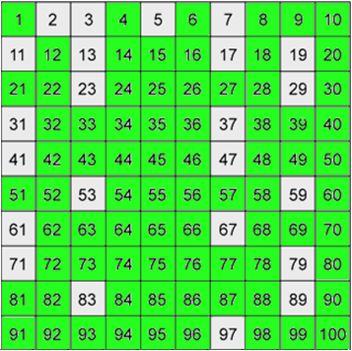
Types of Numbers
Prime numbers
??
What do you think the green numbers are?

Slide 58
Types of Numbers: Composite Numbers
Composite Numbers!

Slide 59
Types of Numbers: Composite Numbers
Have you ever heard of the term “composite” numbers?

Slide 60
Types of Numbers: Composite Numbers
Composite numbers are numbers that can be
divided by
at least two numbers, and
themselves
to equal a whole number.
WT?

Slide 61
Types of Numbers: Composite Numbers
Composite numbers are numbers that can be
divided by
at least two numbers, and
themselves
to equal a whole number.
That’s easy!
So 7 can only be made using two factors: 7 and 1 (7x1).
That’s why we can call it a prime number!

Slide 62
Types of Numbers: Composite Numbers
Also known as:
Composite numbers are numbers that have more than one factor (e.g. 9 = 3x3 and 9x1)
WT?

Slide 63
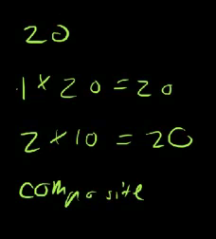
Types of Numbers: Composite Numbers
Also known as:
Composite numbers are numbers that have more than one factor (e.g. 9 = 3x3 and 9x1)
That’s easy!
So 20 can be made using more than two factors: 1 & 20 (1x20) 2 & 10 (2x10) and
4 & 5 (4 x 5).
That’s why we can call it a composite number!

Slide 64
Types of Numbers: Composite Numbers
Let’s test the division theory out!
Choose any green number (i.e. 99).
On your calculator try:
99 /12 =
99/ 11 =
Heading: Composite Numbers
If you find a number that your number can be divided by write it into your book.
For example: 99 can be divided by 11: 99 / 11 = 9

Slide 65
Types of Numbers: Composite Numbers
Let’s test the factors theory out!
Choose any green number (i.e. 20).
List all the factors of that number you know
(i.e. 20=4x5,2x10, 1x20)
Heading: Composite Numbers
If you find a number that your number can be divided by write the factors into your book.
For example: 99 = 11 x 9
99 = 33 x 3 etc..

Slide 66
Types of Numbers
What do you think you get if you multiply a prime number by a prime number? (Try it a few times using the prime numbers in the box below)
prime number x prime number = ?

Slide 67
Types of Numbers
Did you know that if you multiply a prime number by a prime number you get a composite number!
When you multiple a prime
number by a prime number we
then call them “prime factors”
? X ? = Factor x factor
2 and 3 (2 x 3) are prime factors!
Heading: Prime Factors
Create at least ten multiplication equations that use only prime factors (prime number x a prime number)

Slide 68
Prime Factors
Heading: Prime Factors
Create at least ten multiplication equations that use only prime factors (prime number x a prime number) using the following table layout:
Prime Factor 1 | Prime Factor 2 | Answer (Composite Number)
2 | 3 | 6

Slide 69
Prime Factors
Let’s see which students really understand prime factors!
Read the following sentence carefully! What is it really asking you?
You have 5 minutes to write down all of the prime factors (not factors, prime factors) for the number 100.

Slide 70
Prime Factors: Method 1
What are the prime factors for the number 100.
A prime factor is (a factor that is also a prime number).
Therefore the prime factors of 100 are 2 & 5
(1, 10, 20, 25 ,50 and 100 are not: they are composite numbers)
Why are 2 and 5 the only prime factors of 100?
The 9 factors of 100 are 1, 2, 4, 5, 10, 20, 25, 50, and 100 (The factor pairs of 100 are 1 x 100, 2 x 50, 4 x 25, 5 x 20, and 10 x 10).
Therefore out of all of those factors of 100 only 2 and 5 are prime numbers (prime factors).

Slide 71
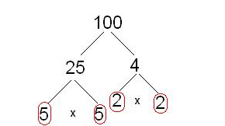
Prime Factors: Method 2
What are the prime factors for the number 100.
Factor trees can help us identify the prime factors.
x
.
.
.
.
Check out your answers using this free online prime factors calculator:
http://www.analyzemath.com/Calculators_3/prime_factors.html

Slide 72
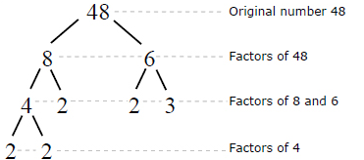
Prime Factors: Factor Trees
Factor trees can help us identify the prime factors
.
Heading: Factor Trees
.
.
Activity:
Try to create your own factor tree for the number 30. Remember: Only use prime numbers as factors (multipliers)
.
http://calculator.tutorvista.com/math/486/factor-tree-calculator.html#

Slide 73
Prime Factorization
Factor 56 using only prime factors.
To do this, we can make a factor tree as follows.
56
28 is composite so we can factor it further.
2 is prime.
2
•
28
14 is composite, so we can factor it further.
2 is prime.
2
•
14
2 is prime.
2
•
7
7 is prime.
The prime factorization of 56 is 2 • 2 • 2 • 7 or 2³ • 7.

Slide 74
Prime Factorization
or
We can make a factor tree using different starting factors.
4 is composite so we can factor it further.
56
14 is composite so we can factor it further.
4
•
14
2
•
2
2
•
7
2 is prime.
7 is prime.
The prime factorization of 56 is 2 • 2 • 2 • 7 or 2³ • 7.
The prime factorization of every number is unique. No matter what factors you choose, the prime factorization will still be the same for that number.

Slide 75
What does this mean?
Representing composite numbers as a product of their prime factors and using this form to simplify calculations by cancelling common primes ← (fractions?)

Slide 76
Did you know?
That if a number is divisible (able to be divided by) by a composite number then…. it is also divisible by the prime factors of that number!
and 4)
WT?
For example
Choose a random number: 785
The last two digits of 785 are 85.
85 is divisible by 5! (don’t worry about the 700; 100 is a composite number therefore so is 700!)

Slide 77
Let’s try that again with another random number.
For example
Choose a random number: 216
The last two digits of 216 are 16.
16 is divisible by 8!
AND
216 is also divisible by 2.
(Remember, don’t worry about the 200; 100 is a composite number therefore so is 200!)

